Slide 1

Austin Transportation Department Signs Work Orders
Created By: Susanne Gov Created Date: 2020-08-10 Location Name: FM 2222 RD / MC NEIL DR Intersection ID: 5147094 Cardinal Direction: N Work Order ID: SG-20826
Sign Type | Install/Remove

Slide 2
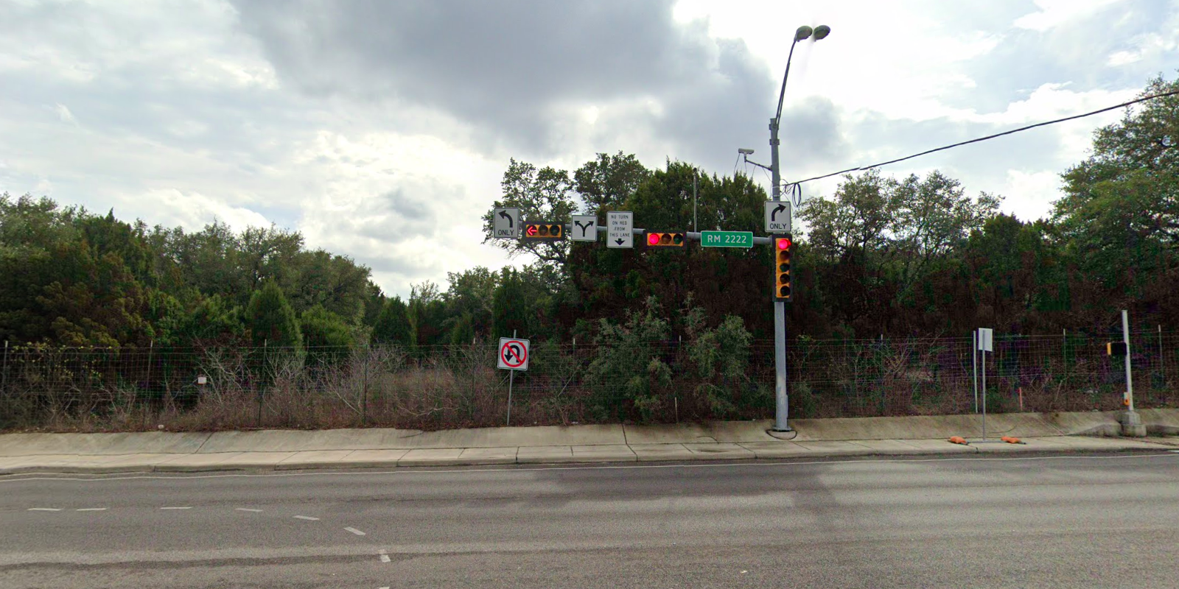
Austin Transportation Department Signs Work Orders
Created By: Susanne Gov Created Date: 2020-08-10 Location Name: FM 2222 RD / MC NEIL DR Intersection ID: 5147094 Cardinal Direction: S Work Order ID: SG-20826
Sign Type | Install/Remove
Street Name Sign | Install
Left Turn Arrow Only | Install
Right Turn Arrow Only | Install
Left Right Turn Arrow | Install
No Turn On Red On This Lane | Install

Slide 3
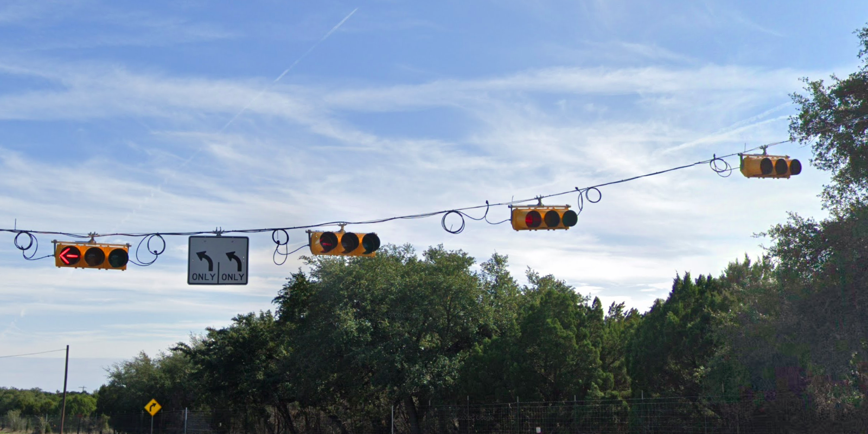
Austin Transportation Department Signs Work Orders
Created By: Susanne Gov Created Date: 2020-08-10 Location Name: FM 2222 RD / MC NEIL DR Intersection ID: 5147094 Cardinal Direction: E Work Order ID: SG-20826
Sign Type | Install/Remove
Left Turn Arrow Only | Install
Left Turn Arrow Only | Install

Slide 4
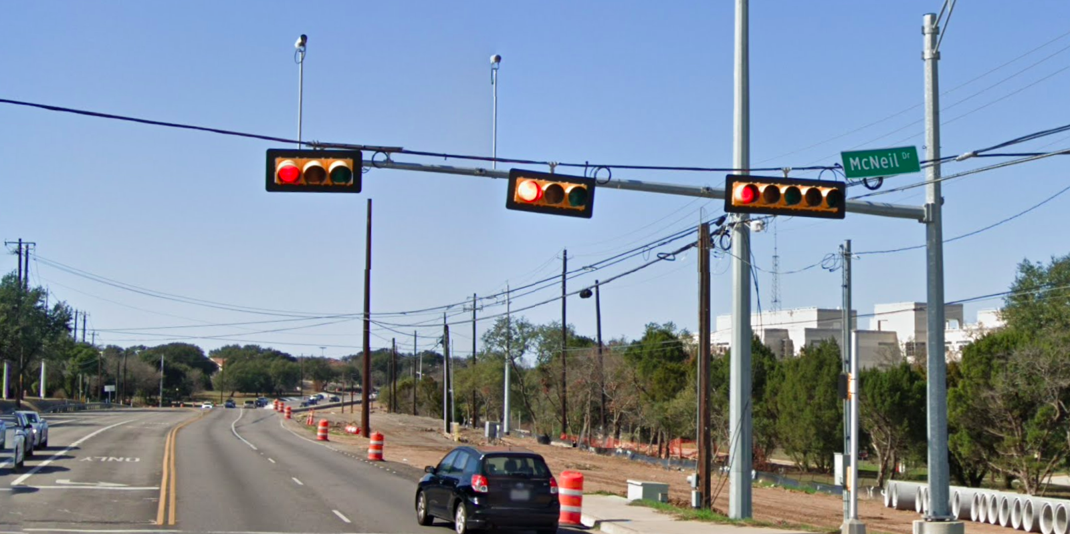
Austin Transportation Department Signs Work Orders
Created By: Susanne Gov Created Date: 2020-08-10 Location Name: FM 2222 RD / MC NEIL DR Intersection ID: 5147094 Cardinal Direction: W Work Order ID: SG-20826
Sign Type | Install/Remove
Street Name Sign | Install

